Slide 1
An Introduction to IoT on Azure
Josh Lane
Principal Architect, Wintellect
https://github.com/jplane/iot-webinar

Slide 2
whois Josh-Lane
Principal Architect at Wintellect
Consulting, training, content development
Almost 20 years as software architect and developer
Focused primarily on .NET, Node.js, and cloud
Microsoft Azure MVP
Azure-in-the-ATL meetup founder
jlane@wintellect.com
@jplane

Slide 4
A Robust IoT platform…
Scales reliably and seamlessly in relation to device count and data ingress/egress
Can uniquely identify, manage, and communicate with each device
Supports bidirectional, occasionally connected, secure device communication
Supports many communication and data formats, but presupposes none
Supports a variety of data processing scenarios (data-at-rest, streaming, event-driven, etc.)
Notes:
Before we talk about Azure specifics, let’s talk about desirable attributes of a generic IoT platform…

Slide 5
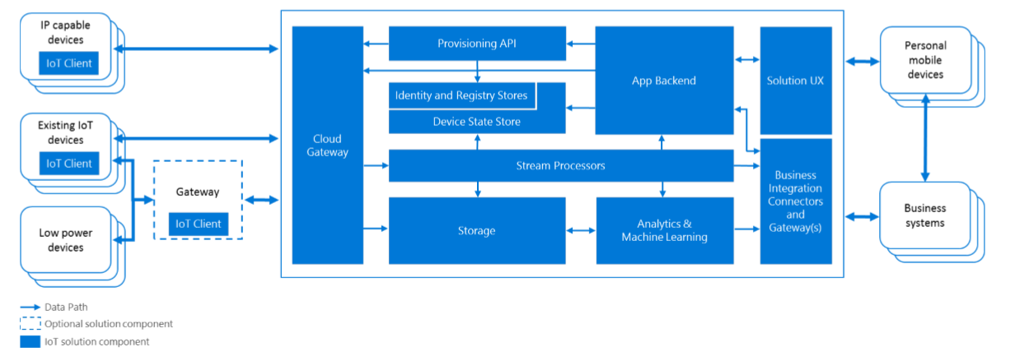
Reference IoT Architecture
Notes:
Going one level deeper, but still technology agnostic, let’s talk about what an IoT architecture consists of.
3 key areas:
Device Connectivity + Management
Data Processing + Analytics
Presentation + Business Connectivity

Slide 6
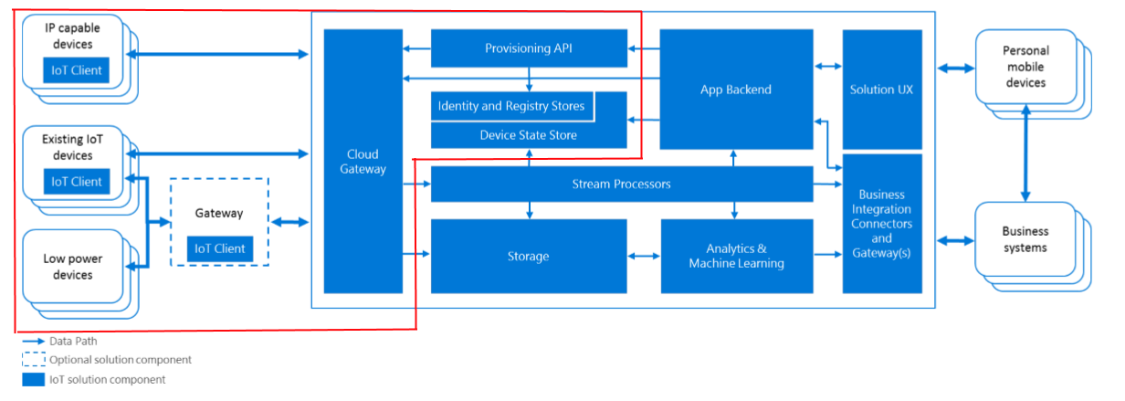
Device Connectivity + Management
Notes:
First and foremost, connect/identify/track devices…
Endpoint management
Protocol negotiation
Device provisioning
Authentication
State management

Slide 7
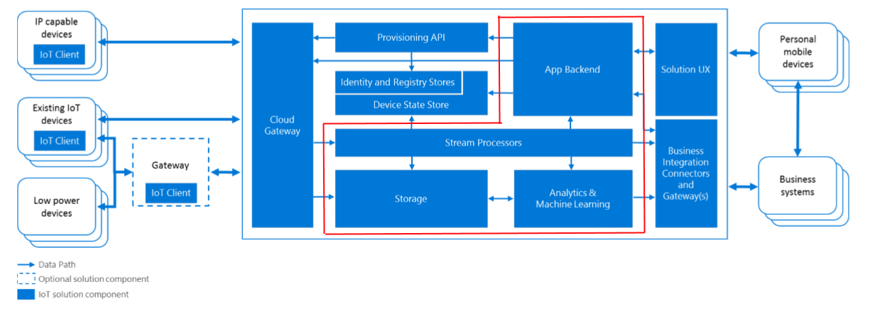
Data Processing + Analytics
Notes:
Want to do interesting things with all this data…
Streaming endpoints
Durable storage
Machine learning, BI, etc.

Slide 8

Presentation + Business Connectivity
Notes:
No IoT solution is an island…
App integration and custom logic
Reporting
Dashboards
External system integration

Slide 9
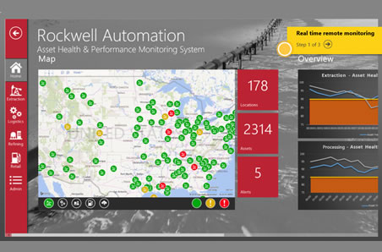
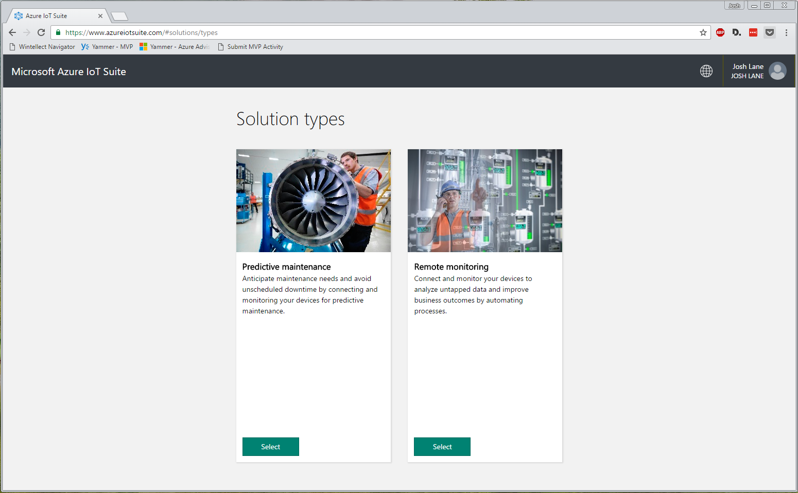
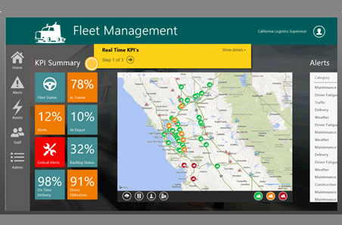
Azure IoT Suite
Set of umbrella technologies + prescriptive scenario guidance
Not a single technology, service, or product
www.azureiotsuite.com
Notes:
References to this are confusing… mostly marketing terminology.
Two main templates:
Remote monitoring
Predictive maintenance

Slide 10
Azure IoT Suite - Ecosystem
Devices – various Linux-, Windows-, Android-, Arduino-based field devices
Data ingest – Azure IoT Hub or Event Hub
Data-at-rest – Azure Storage, DocumentDB, Data Lake, SQL Database
Streaming
Stream Analytics, Apache Storm (HDInsight), Event Hubs
IoT Hub supports Event Hub API (custom processing w/ EventProcessorHost, etc.)
Analytics
HDInsight, SQL Data Warehouse, Power BI, Azure ML, Azure Batch
Business and data transformation logic
Service Fabric actors, Functions, Data Factory, Logic Apps
Typically a combination of the above

Slide 11
Azure IoT Hub
Core element of Azure IoT Suite
Secure, cloud-scale IoT gateway
Conduit between biz logic, analytics, etc. and devices
Provision, manage, communicate with millions of devices
Per-device authentication and authorization
Bidirectional device communication
Telemetry, (un)provision, update firmware, reboot, custom commands, etc.
HTTP, AMQP, AMQP-WS, MQTT, custom
Durable, TTL-based message store for intermittent device connectivity

Slide 12
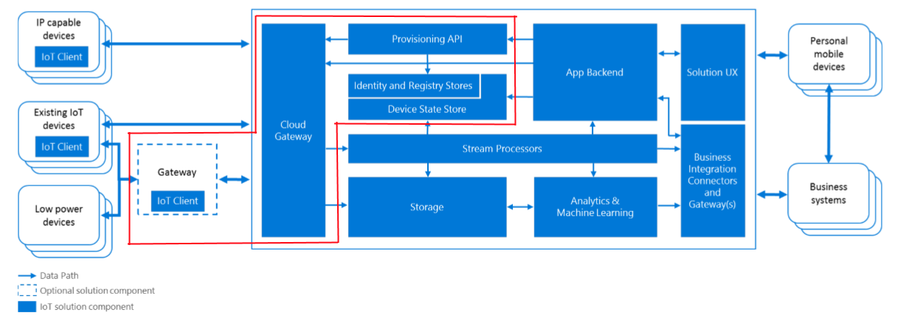
Azure IoT Hub
Notes:
Encompasses three main capabilities:
Cloud gateway
Field gateway (Gateway SDK)
Device identity, provisioning, state management

Slide 13
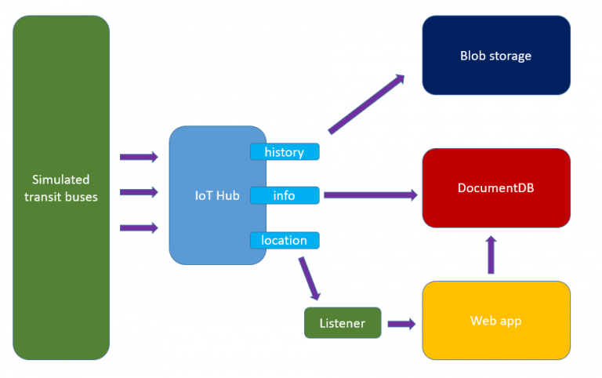
Transit Bus Tracker
Notes:
Simulated transit buses as IoT “devices” that report status (remote monitoring)
Talk to Azure IoT Hub which exposes 3 consumer groups
Blob storage for archival
DocumentDB for “current state”
Custom listener code for real-time updates on web portal using Google Maps

Slide 14
Device → Cloud
Native protocols
Device SDKs for a variety of platforms and languages
Debian, Ubuntu, RaspberryPI, Android, Windows
Node.js, Java, Python, C, .NET
File upload
Event Hub-compatible messaging
Gateway SDK
Custom protocols, edge analytics/auth/rules, traffic optimization/batching, etc.
Notes:
Let’s talk more specifically about what device to cloud messaging looks like in IoT Hub…

Slide 15
Cloud → Device
Reboot
Factory reset
Firmware update
Command and control
Direct, custom command to device(s)… now or scheduled
Configuration changes
desired vs. reported state
Device metadata query
Notes:
All supported by IoT Hub
Based on LWM2M (Lightweight Machine to Machine) protocol
Relies on concept of “device twin” which is cloud-stored metadata synchronized with physical devices

Slide 16
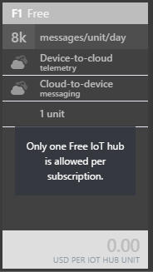
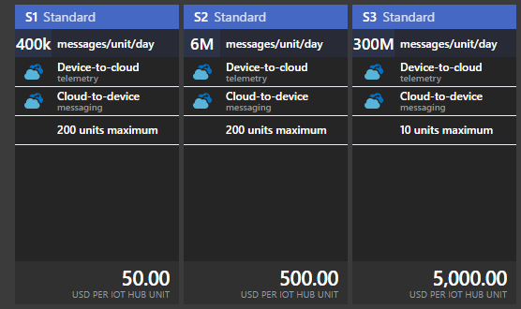
Pricing
Notes:
A “unit” is a logical measure of desired scale
# of units needed == (device count * messages/device/day)

Slide 17
References
Azure IoT Suite - https://azure.microsoft.com/en-us/suites/iot-suite/
IoT Reference architecture - https://azure.microsoft.com/en-us/updates/microsoft-azure-iot-reference-architecture-available/
IoT Hub developer docs - https://azure.microsoft.com/en-us/documentation/services/iot-hub/
“Microservices, IoT, and Azure” - https://www.amazon.com/Microservices-IoT-Azure-Microservice-Architecture/dp/1484212762
Open Mobile Alliance LWM2M spec - http://technical.openmobilealliance.org/Technical/technical-information/release-program/current-releases/oma-lightweightm2m-v1-0
Azure IoT Hardware and SDK compatibility - https://azure.microsoft.com/en-us/documentation/articles/iot-hub-tested-configurations/
Azure IoT Device and Service SDKs - https://github.com/Azure/azure-iot-sdks

Slide 18
Thank You!

